Slide 1
Artificial Intelligence (AI-2002)
Chapter 6: Constraint Satisfaction Problem

Slide 2
Objectives
Backtracking
MRV and degree heuristic
Forward checking
Improvement in forward check (through heuristic combination)
MAC (maintaining arc consistency)
Back jumping
Intelligent backtracking (constraint learning )

Slide 3
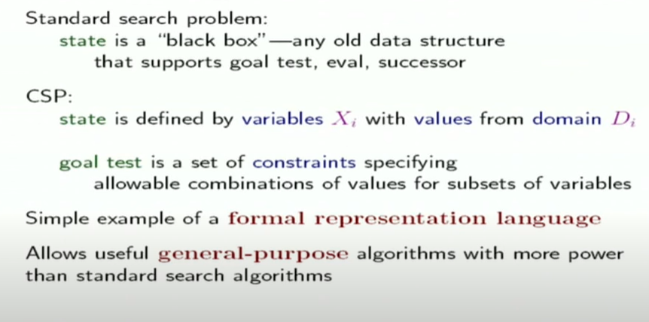
Constraint Satisfaction Problem

Slide 4
Constraint Satisfaction Problem
So far, Search space states evaluated by heuristics and goal.
A constraint satisfaction problem (CSP) is a problem that requires its solution within some limitations/conditions also known as constraints.
For which the typical problems can be converted to CSP and solved.

Slide 5
Converting problems to CSPs
A problem to be converted to CSP requires the following steps:
Step 1: Create a variable set.(Representing state)
Step 2: Create a domain set.(values)
Step 3: Create a constraint set with variables and domains after considering the constraints.(limitations)

Slide 6
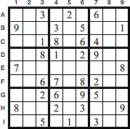
CSP Example1-Sudoku
Rule: Fill all empty Squares so that the numbers 1 to 9 appear once in each row, column and 3x3 box
VARIABLES – variables are cells (A1-I9)
DOMAIN – domain of each variable is
{1,2,3,4,5,6,7,8,9}
CONSTRAINT– constraints: rows, columns, boxes contain all different
numbers

Slide 7
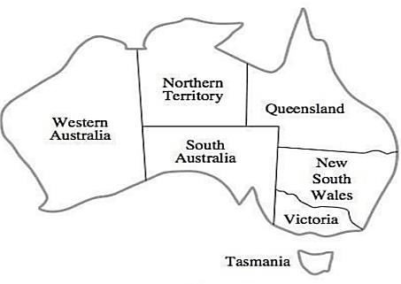
Example2-Map Coloring
Rule - Color each region either red, green or blue
- No adjacent region can have the same color

Slide 8
Map Coloring

Slide 9
Map Coloring
Variables:
WA, NT, SA, Q, NSW, V, T
Domains:
D = {R , G, B}
Constraints:
adjacent regions must have different colors
WA != NT
(WA, NT) in {(R,G), (R,B), (B,G), … }
Solutions are assignments satisfying all constraints, e.g.:

Slide 10
Constraint Graphs
 | WA | NT | SA | Q | NSW | V
WA |  | 1 | 1 | 0 | 0 | 0
NT | 1 |  | 1 | 1 | 0 | 0
SA | 1 | 1 |  | 1 | 1 | 1
Q | 0 | 1 | 1 |  | 1 | 0
NSW | 0 | 0 | 1 | 1 | 0 | 1
V | 0 | 0 | 1 | 0 | 1 | 0

Slide 11
Constraint Graphs
Binary CSP: each constraint relates (at most) two variables
Binary constraint graph: nodes are variables, arcs show constraints
General-purpose CSP algorithms use the graph structure to speed up search. E.g., Tasmania is an independent sub problem!
Notes:
Demo:
Run constraint.jar or constraint.exe, load the 5 queens problem.
Demo is just showing the n-queens applet as illustration of constraint graph, but later in lecture we’ll interact with the applet.
aispace.org will have the latest version

Slide 12
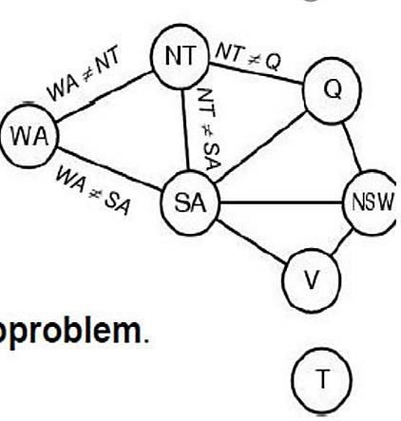

CSP Representation of Map Coloring
Variables: WA, NT, Q, NSW, V, SA, T
Domains: Di = {red, green, blue} Constraints: adjacent regions must have different colors
e.g., WA ≠ NT, or (WA,NT)
Constraint Graph
Nodes are Variables
Arcs are Constraint

Slide 13
Varieties of constraints
Unary constraints involve a single variable, e.g. SA ≠ green
Binary constraints involve pairs of variables (relates two variables),e.g., SA ≠ WA
Higher-order constraints involve 3 or more variables, e.g. cryptarithmetic puzzles (column constraints)

Slide 14
BACKTRACKING

Slide 15
Backtracking search
Depth-first search for CSPs with single-variable assignments is called backtracking search
Variable assignments are commutative: [ WA = red then NT = green ] same as [ NT = green then WA = red ]
Only need to consider assignments to a single variable at each node
Backtracks when variable has no legal value

Slide 16
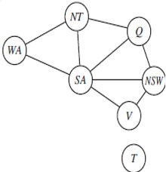
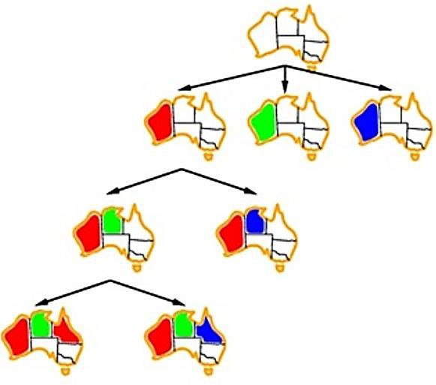
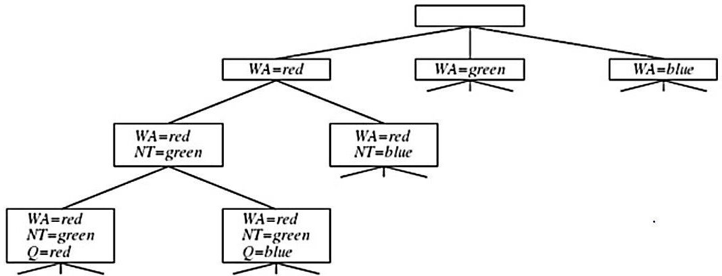

Backtracking for the map-coloring problem

Slide 17
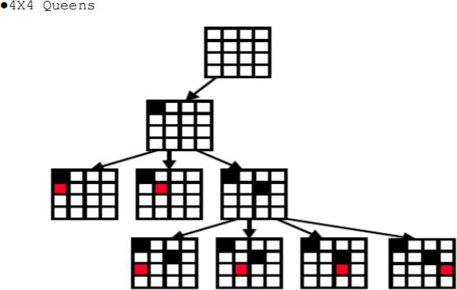
Backtracking Example:2

Slide 18
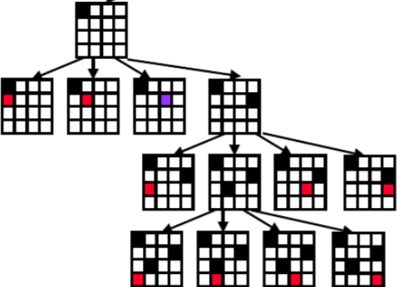

Slide 19
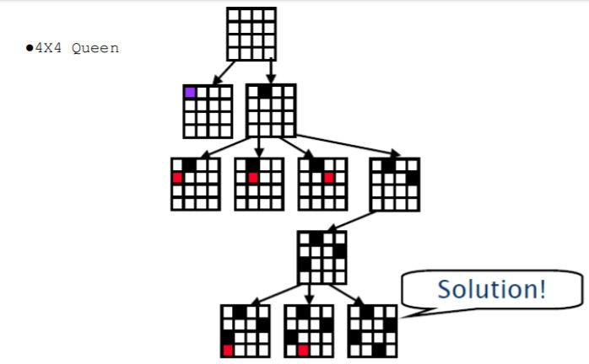

Slide 20
Backtracking search
Backtracking = DFS + variable-ordering + fail-on-violation

Slide 21
Improving backtracking efficiency (Variable and Value Ordering)
By default, Backtrack algorithm simply selects the next unassigned variable in the order given by the list VARIABLES[csp].
General-purpose methods can give huge gains in speed:
Which variable should be assigned next?
In what order should its values be tried ?
Can we detect inevitable failure early?

Slide 22
Ordering

Slide 23
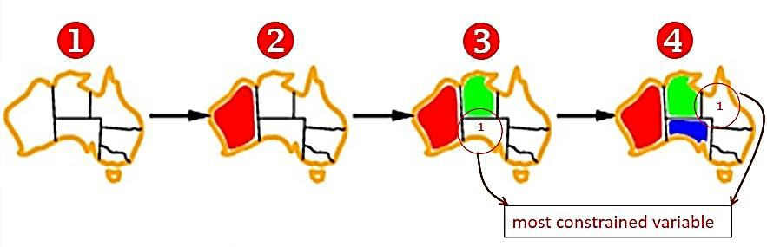
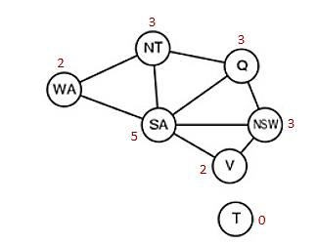
Minimum remaining values (MRV)
This intuitive idea-choosing the variable with the fewest "legal" values is called the minimum remaining values (MRV) heuristic (also known most constrained variable)
WA=(2)Red
NT(Remaining values)=2(Blue , Green)
while Q and NSW have 3 remaining values so, go for NT
SA( Remaining values)= 1(Blue)
after the assignments for WA = red and NT = green, there is only one possible value for SA, so it makes sense to assign SA = blue next rather than assigning Q, after SA is assigned, the choices for Q, NS W, and V are all forced.

Slide 24

Most-Constraining Variable (Degree Heuristics)
Most constraining variable: choose the variable with the most constraints on remaining variables
SA=5 (Most Constraints) BLUE
NT, Q, NSW = 3 TIE b/w them break it by choosing the
first choice either NT or NSW.
So, choose NT Then Q, NSW OR Q, Then Q and NT

Slide 25
Filtering

Slide 26
Filtering: Forward Checking
Filtering: Keep track of domains for unassigned variables and cross off bad options
Forward checking: Cross off values that violate a constraint when added to the existing assignment
Notes:
Demo:
CS188 javascript demos -> source -> exercises -> csps -> CSPs demos -> CSPs demos.html
Settings:
Graph = Simple
Algorithm = Backtracking
Ordering = None
Filtering = Forward Checking

Slide 27
Filtering: Forward Checking
Filtering: Keep track of domains for unassigned variables and cross off bad options
Forward checking: Cross off values that violate a constraint when added to the existing assignment
WA
NT
Q
SA
NSW
V
Notes:
Demo:
CS188 javascript demos -> source -> exercises -> csps -> CSPs demos -> CSPs demos.html
Settings:
Graph = Simple
Algorithm = Backtracking
Ordering = None
Filtering = Forward Checking

Slide 28
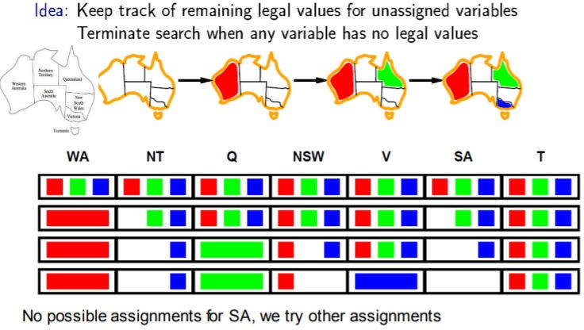
Forward Checking

Slide 29
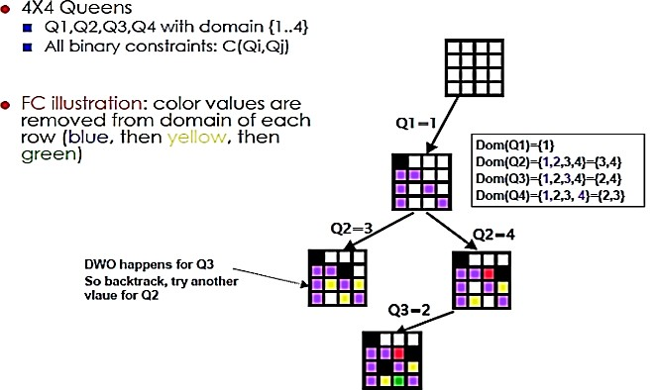
Forward Checking Example:2

Slide 30
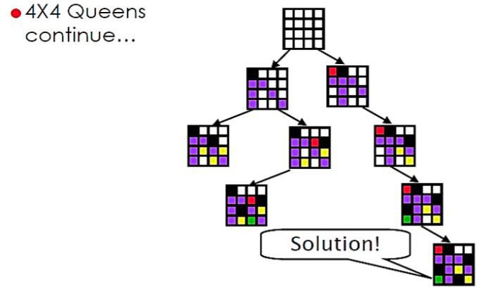
Forward Checking Example:2……

Slide 31
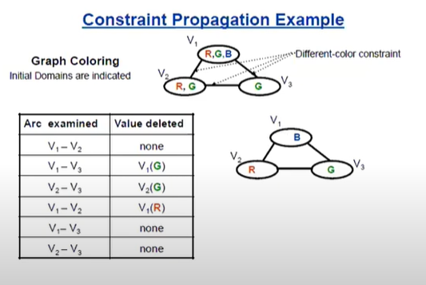
ARC Consistency

Slide 32
Consistency of A Single Arc
An arc X → Y is consistent iff for every x in the tail there is some y in the head which could be assigned without violating a constraint
Forward checking: Enforcing consistency of arcs pointing to each new assignment
NT
Q
WA
SA
NSW
V
Delete from the tail!

Slide 33
Arc Consistency of an Entire CSP
A simple form of propagation makes sure all arcs are consistent:
Important: If X loses a value, neighbors of X need to be rechecked!
Arc consistency detects failure earlier than forward checking
Can be run as a preprocessor or after each assignment
What’s the downside of enforcing arc consistency?
NT
Q
WA
SA
NSW
V
Remember: Delete from the tail!

Slide 34
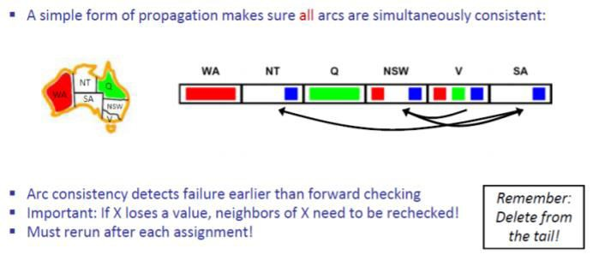
ARC Consistency

Slide 35
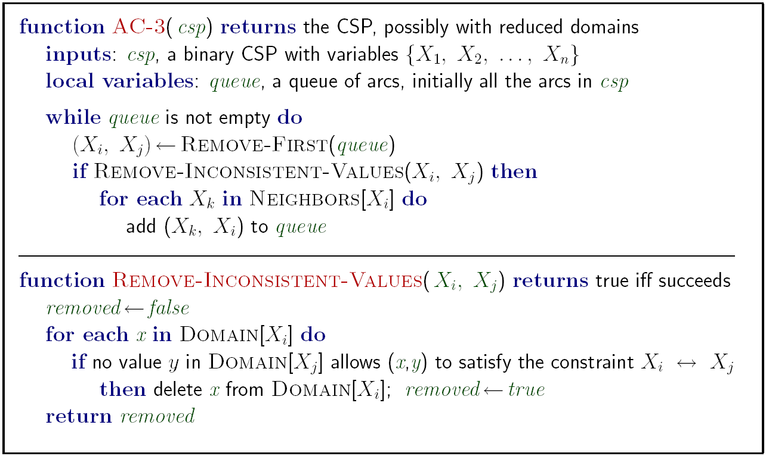

Slide 36
Limitations of Arc Consistency
After enforcing arc consistency:
Can have one solution left
Can have multiple solutions left
Can have no solutions left (and not know it)
Arc consistency still runs inside a backtracking search!
What went wrong here?
Notes:
Demo:
CS188 javascript demos -> source -> exercises -> csps -> CSPs demos -> CSPs demos.html
Settings:
Graph = Complex
Algorithm = Backtracking
Ordering = None
Filtering = Forward Checking (first) / Arc Consistency (second)

Slide 37
Cryptarithmetic

Slide 41
Example: 4-Queens Problem
X1 {1,2,3,4}
X3 {1,2,3,4}
X2 {1,2,3,4}
X4 {1,2,3,4}
1 2 3 4
1
2
3
4

Slide 42
Example: 4-Queens Problem
X1 {1,2,3,4}
X3 {1,2,3,4}
X2 {1,2,3,4}
X4 {1,2,3,4}
1 2 3 4
1
2
3
4

Slide 43
Example: 4-Queens Problem
X1 {1,2,3,4}
X3 { ,2, ,4}
X2 { , ,3,4}
X4 { ,2,3, }
1 2 3 4
1
2
3
4

Slide 44
Example: 4-Queens Problem
X1 {1,2,3,4}
X3 { ,2, ,4}
X2 { , ,3,4}
X4 { ,2,3, }
1 2 3 4
1
2
3
4

Slide 45
Example: 4-Queens Problem
X1 {1,2,3,4}
X3 { , , , }
X2 { , ,3,4}
X4 { ,2,3, }
1 2 3 4
1
2
3
4

Slide 46
Example: 4-Queens Problem
X1 { ,2,3,4}
X3 {1,2,3,4}
X2 {1,2,3,4}
X4 {1,2,3,4}
1 2 3 4
1
2
3
4

Slide 47
Example: 4-Queens Problem
X1 { ,2,3,4}
X3 {1, ,3, }
X2 { , , ,4}
X4 {1, ,3,4}
1 2 3 4
1
2
3
4

Slide 48
Example: 4-Queens Problem
X1 { ,2,3,4}
X3 {1, ,3, }
X2 { , , ,4}
X4 {1, ,3,4}
1 2 3 4
1
2
3
4

Slide 49
Example: 4-Queens Problem
X1 { ,2,3,4}
X3 {1, , , }
X2 { , , ,4}
X4 {1, ,3, }
1 2 3 4
1
2
3
4

Slide 50
Example: 4-Queens Problem
X1 { ,2,3,4}
X3 {1, , , }
X2 { , , ,4}
X4 {1, ,3, }
1 2 3 4
1
2
3
4

Slide 51
Example: 4-Queens Problem
X1 { ,2,3,4}
X3 {1, , , }
X2 { , , ,4}
X4 { , ,3, }
1 2 3 4
1
2
3
4

Slide 52
Example: 4-Queens Problem
X1 { ,2,3,4}
X3 {1, , , }
X2 { , , ,4}
X4 { , ,3, }
1 2 3 4
1
2
3
4

Slide 53
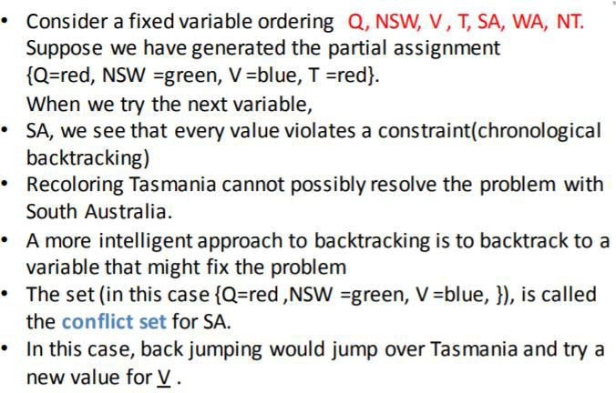
Intelligent Backtracking: Looking Backward

